Slide 1
代码质量、规范和两人合作
邹欣
构建之法
2015

Slide 2
Course content
《构建之法》第四章
<Code Complete II> Chapter 25, 26

Slide 3
Agenda
What is solid code?
Coding conventions
How to achieve solid code?
Code review
Pair programming
What’s great code?
How to achieve great code?
How to influence people?

Slide 4
Code Quality
We write code for the machine, or for people?
Both

Slide 5
Clever Code or Good Code?
#include "stdafx.h"
#include "stdio.h"
void test ();
int _tmain
(int argc,
_TCHAR* argv[])
{ test(); return
0; } char C[25]
[40];void d(int x,
int y) {C[x][y]=
C[x][y+1]=32;}
int f(int x){return
(int)x*x*.08;}
void test(){int i,j;
char s[5]="TEST";
for(i=0;i<25;i++)
for(j=0;j<40;j++)
C[i][j]=s[(i+j)%4];
for(i=1;i<=7;i++)
{d(18-i,12);
C[20-f(i)][i+19]=
C[20-f(i)][20-i]=32;
}d(10,13);d(9,13);
d(8,14);d(7,15);
d(6,16);d(5,18);d(5,20); d(5,22);d(5,26);
d(6,23);d(6,25);d(7,25);for(i=0;i<25;i++,printf("\n"))
for(j=0;j<40;printf("%c",C[i][j++]));
scanf("%c", &s[0]);
}

Slide 6
运行这个程序
看看输出是啥

Slide 7
It looks like clever code
巧妙的代码 vs. 易懂的代码
The shape of the source code is the comment!
But how can we maintain it?
What if I want to print a “D”? How do we change it?

Slide 8
So, it’s still for human
你的代码决定了你的RP
Software project team is a little society
You don’t want to have a low RP
The earlier we can fix an issue, the better
So start with code review
Move it even earlier -> have it reviewed when you’re writing the code
Pair Programming

Slide 9
Broken Window (破窗理论)
Broken Window Theory
A few broken windows ->
more broken windows ->
vandalizing the house
Litter on a sidewalk ->
more litter ->
becomes an dumping ground ->
unsafe street
Example - New York City
Start from small violations, strictly enforce the law
Clean up subway and subway cars, every line, every car, everyday
Notes:
"Consider a building with a few broken windows. If the windows are not repaired, the tendency is for vandals to break a few more windows. Eventually, they may even break into the building, and if it's unoccupied, perhaps become squatters or light fires inside. Or consider a sidewalk. Some litter accumulates. Soon, more litter accumulates. Eventually, people even start leaving bags of trash from take-out restaurants there or breaking into cars."

Slide 10
Broken window in software
The psychology of bugs
Broken window theory also applies here!
If there are bugs not getting fixed for a long time, why bother with current code quality?
If the build doesn’t work at all, why bother improving code quality?

Slide 11
What’s solid code?
Professionals need solid code
ZERO defect
easy to understand
Define your assumption explicitly
Easy to maintain
Define your dependency explicitly

Slide 12
Coding Style
concise, consistent, unambiguous
Indentation
Line width
Parenthesis
Naming
Upper/lower case
Underscore “_”
camel style
Pascal style
Verb-noun
Acronym or not
comment

Slide 13
Comment – over coment
Protected Sub txtSSN_TextChanged(ByVal sender As Object, ByVal e As System.EventArgs) Handles txtSSN.TextChanged
Try ‘Provides error trapping
'_______________________________________________________________________ '
' txtSSN_TextChanged
‘ Activated by entering SSN.
' Transfer form value to local class variable. '_______________________________________________________________________ '
' anOrder.SSN
' Holds the SSN for processing in all forms ' txtSSN ' Form object that holds user entered SSN ' '_______________________________________________________________________ '
anOrder.SSN = txtSSN.Text
Catch ex As Exception ' Error trapping. '_______________________________________________________________________ ‘
' Output system error message to user on form under form title and
' send details to database
'_______________________________________________________________________ ' subErrorReporting("txtSSN_TextChanged", ex.Message)
End Try
End Sub

Slide 14
Header Comment
Comment What (high level) and How
Use consistent format
Document owner, important changes
Keep other detail information in check-in comments

Slide 15
In-body comment
Comment How, not What
sparse enough that you only notice them when you need them,
but detailed enough that they make the surprises apparent.
Avoid common knowledge
don't tell us about common language features, standard library functions,
or standard idioms like iteration.
Dev can get such information from the code itself
Comment style in language Text book is different from Comment Style in product
Text book: explain basic ideas, as part of teaching

Slide 16
Design guideline
Function
Do one thing, do it well
Error handling
Parameter
Assertion
Exception handling
Threading
Performance
Security

Slide 17
Coding Standard Discussion
Why Hungarian? Why not?
Strong type/weak type
Error handling
Parameter – check
Assert
Debug build can be 3x slower than retail build.
Crash or work around it?

Slide 18
Code Review
名 称 | 形 式 | 目 的
自我复审 (self review) | 自己 vs. 自己 | 用同伴复审的标准来要求自己。不一定最有效，因为开发者对自己总是过于自信。如果能持之以恒，则对个人有很大好处
同伴复审 (Peer Review) | 复审者 vs. 开发者 | 简便易行
团队复审 (Team Review) | 团队 vs. 开发者 | 有比较严格的规定和流程，用于关键的代码，以及复审后不再更新的代码。 覆盖率高——有很多双眼睛盯着程序。但是有可能效率不高（全体人员都要到会）

Slide 19
Code review
If the reviewer doesn’t spot any errors, is it still a useful code review session?
Yes
Spread the knowledge
Let other people learn (they can learn more than your words)
Mentally re-exam your code and logic
Many people realize errors when describe their code to people

Slide 20
课堂练习
Each team pick up a piece of code
Decide on a coding convention and design guideline
Review & Report
Is it easy to understand?
Is it Correct?
Can it be improved?
How does it fit your coding convention?
Share the result in blog, like:
http://www.cnblogs.com/panacea/p/4850385.html
http://www.cnblogs.com/kanelim/p/4842157.html

Slide 21
Great code
Solid code +
Well structured
Design Pattern
Easy to evolve
Design for change
Outlook provider
Band-aided system,
kids building blocks
Scale well

Slide 22
Attitude
Bugs don’t just ‘go away’
Too much effort if dev look for a bug in a earlier source?
Don’t fix bugs later, fix them now.
Fix the cause, not the symptom.
Take the time to find the correct solution (trying is not good enough)

Slide 23
Attitude (cont.)
Don’t clean up code unless the clean-up is critical to the product’s success.
Don’t implement non-strategic features
There are no free features
Outlook example

Slide 24
Attitude (cont.)
Don’t allow unnecessary flexibility. (easy to use, but not too flexible)
void *realloc( void *memblock, size_t size );
The realloc function changes the size of an allocated memory block. The memblock argument points to the beginning of the memory block. If memblock is NULL, realloc behaves the same way as malloc and allocates a new block of size bytes. If memblock is not NULL, it should be a pointer returned by a previous call to calloc, malloc, or realloc.

Slide 25
Attitude (cont.)
Write and test code in small chunks
Always test your code, even if that means your schedule will slip
Nobody remembers if you project is late, but many people will remember your product is buggy.

Slide 26
Attitude (cont.)
Don’t rely on the testers to find your bugs.
Don’t blame testers for finding your bugs.
A bug maybe minor; the fact that it exists is serious.

Slide 27
Zero defect - solution
Code review / code inspection
don’t trust anyone – defensive programming
Document your design and interface

Slide 28
Zero defect – solution (cont.)
Test Driven Development - TDD
Competing designs and implementations
Self-validation
Step thru all you code
White box testing
Presumed guilty

Slide 29
Before you code gets in…
Self-review
Peer-review
Buddy-test
Buddy-build
Smoke-test
Check-in test
BVT Build-verification-test

Slide 30
After you fix a bug
Any similar bugs existing in our code?
How could I have automatically detected this bug?
How could I have prevented this bug?
How could I prevent similar bug in the future?

Slide 31
It’s a team effort
Should I…
Fix the symptom
Fix the root cause
Refactor
Rewrite?
Need other’s help, especially …
PM
SDET
Business representatives

Slide 32
The bug you don’t want to fix
Excel example

Slide 33
Quiz
#define ASSERT ( condition, message) \
if (!(condition)) { \
LogError(message); \
} \

Slide 34
quiz
//get input i
ASSERT(nTotal > ++i);
// dealing with i;

Slide 35
Defensive Programming
Does the routine protect itself from bad input data?
Have you use assertions to document assumptions, including pre-condition and post-conditions?
Have assertions been used only to document conditions that should never occur?
Does the architecture or high-level design specify a specific set of error-handling techniques?

Slide 36
Exception handling
Has your project defined a standardized approach to exception handling?
Have you considered alternatives to using an exception?
can the error be handled locally?
Does the code avoid throwing exceptions in constructors and destructors?
Are all exceptions at the appropriate levels of abstraction for the routines that throw them?

Slide 37
Exception handling (cont.)
Does each exception include all relevant exception background info?
Is the code free of empty catch blocks?

Slide 38
Code Review
If we always do Code Review
Then
We’re doing “Pair Programming”

Slide 39
Team Work
“Talent wins games, but teamwork and intelligence wins championships.”
- Michael Jordan
Teamwork start with 1:1 Collaboration
Let’s start by studying how 2 persons work together.

Slide 40
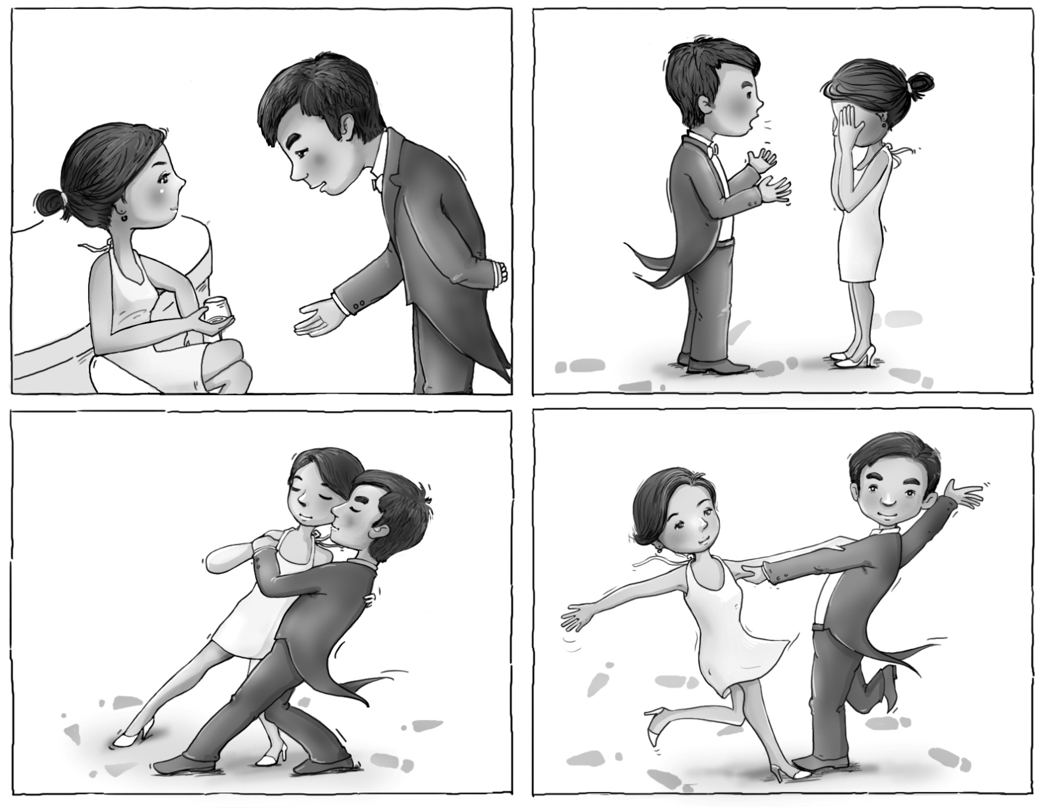
Collaboration

Slide 41
结对编程
代码复审的好处
既然代码复审能发现这么多问题，有这么好的效果，如果我们每时每刻都处在代码复审的状态， 那不是很好么？
事实上，极限编程（Extreme Programming）正是这一思想的体现— 为什么不把一些卓有成效的开发方法用到极致（Extreme），让我们无时不刻地使用它们？

Slide 42
最早有记录的结对编程
1987 年，Intuit 公司（当时只是一个刚刚起步的个人财务管理软件公司）宣布4 月会向客户提供新版本的软件（4 月15 日是美国报税的截止日期）。
但到了3 月末，公司仅有的两个技术人员发现进度还是大大落后于预期，
于是这两人在3 月的最后一周开展了不得已的、长达60 个小时的结对编程活动

Slide 43
Pair Programming
Driver / Navigator (observer)
Rotate once in a while
While reviewing, the observer also
considers the strategic direction of the work,
coming up with ideas for improvements and likely future problems to address.
Driver
Focus on the "tactical" aspects of completing the current task,
using the observer as a safety net and guide.

Slide 44
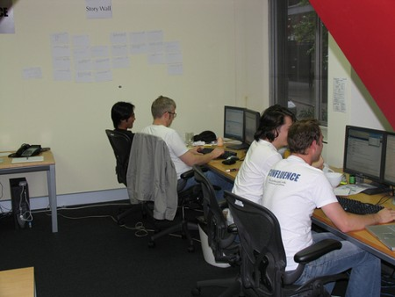
Pair Programming Examples

Slide 45
好处
提高设计质量/Design quality:
Shorter programs, better designs, fewer bugs.
降低成本/Reduced cost of development:
Learning and training: Knowledge passes easily between pair programmers
提高解决问题的信心/Overcoming difficult problems:
Pairs often find that seemingly "impossible" problems become easy or even quick to solve

Slide 46
好处
提高士气/Improved morale:
Programmers report greater joy in their work and greater confidence that their work is correct.
减轻风险/Decreased management risk:
Since knowledge of the system is shared among programmers, there is less risk to management if one programmer leaves the team.
提高效率/Increased discipline and better time management:
The pair partner "keeps them honest".
两人在一起不好意思偷懒或开小差上网

Slide 47
坏处/Drawbacks
工作方式的不同/Working style preference
Most people prefer to work alone
让人感觉到威胁/Intimidation
Expert to novice
时间可能花在培训上面/Tutoring Cost
Expert to novice
对个人情绪，自尊的影响/Ego and Potential conflict
“my code” vs. “your code”

Slide 48
最合适的场景
Reduce number of bugs
Novice – Novice pair
Explore new areas
Transfer knowledge and skills

Slide 49
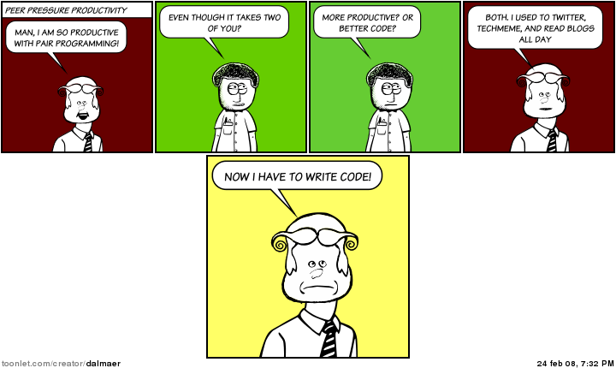
Pair Programming Side Effect

Slide 50
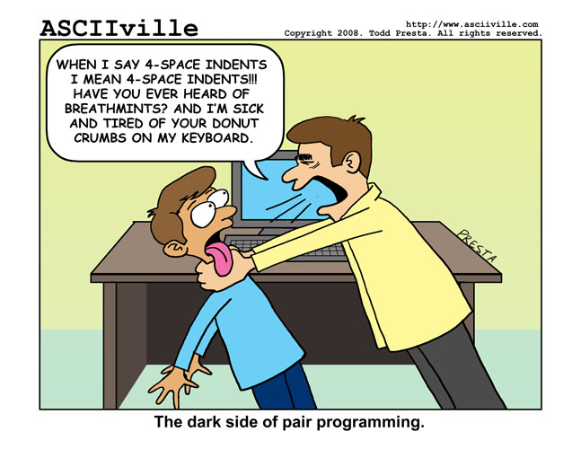
Pair Programming Goes Wrong

Slide 51
Famous collaboration of a pair
In Chinese History
周瑜 – 诸葛亮
管宁 – 华歆

Slide 52
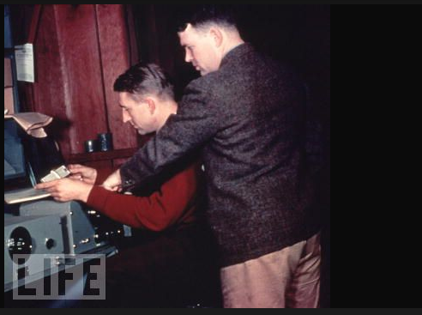
Examples: Hewlett and Packard

Slide 53
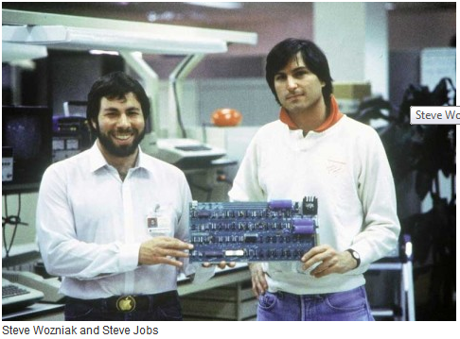
Examples – Wozniak and Jobs

Slide 54
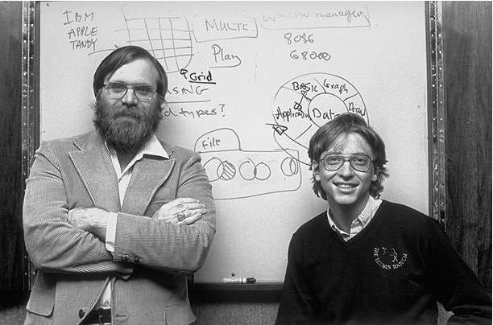
Paul and Bill

Slide 55
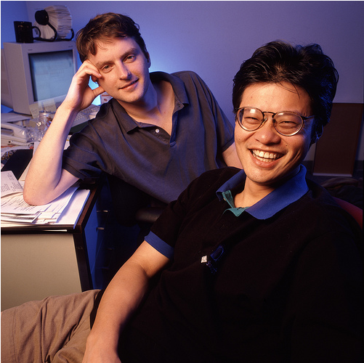
Jerry Yang and David Filo

Slide 56
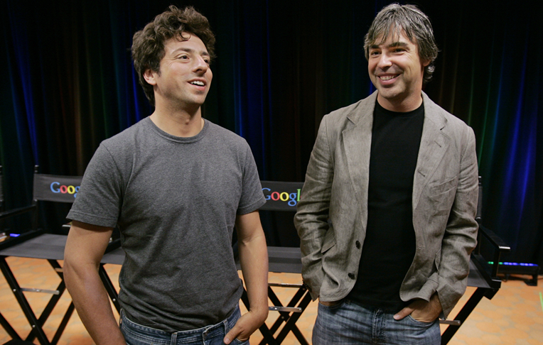
Page and Brin

Slide 57

Facebook: Mark and Eduardo

Slide 58
In IT history
Hewlett Packard
Microsoft (Bill Gates, Paul Allen)
Apple (Steve Jobs, Steve Wozniak)
Yahoo (Jerry Yang, David Filo)
Google (Sergei Brin, Lawrence Page)
Who are the future pairs?

Slide 59
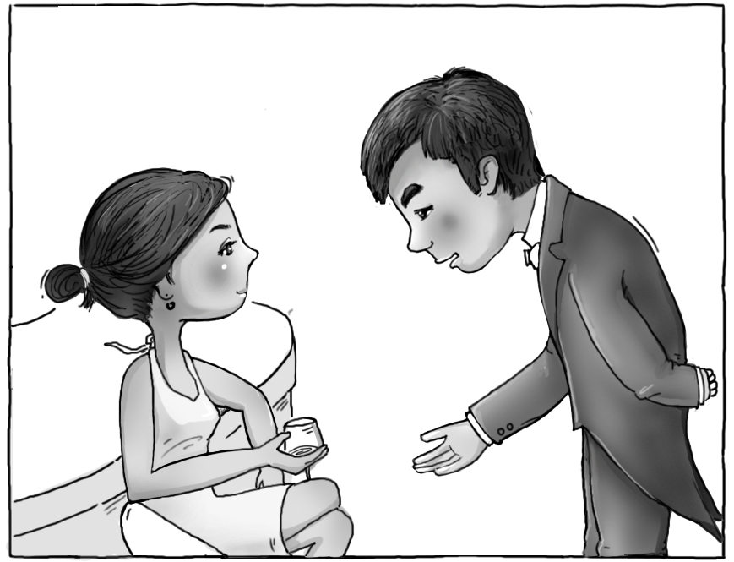
1: forming / 萌芽

Slide 60
课堂练习：How to FORM better
发现共同点/Find common grounds
任意两个本来不熟悉的同学
找到共同点/Find common things (thoughts about software engineering, programming language, background, hobby, social network, dreams, political view points, etc. )
向全班报告/Report to the class
Award the pair with most common things together
Do this in 10 minutes

Slide 61
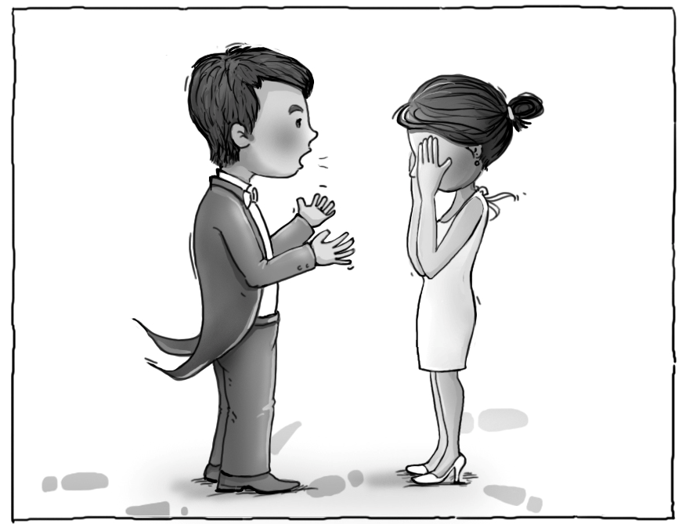
2: Storming / 磨合

Slide 62
如何磨合/How to storm better
提供直接的反馈/Provide feedback
If you only have one critical feedback to say about your partner
Deliver it as a sandwich
Make it into 3 things to say…
面包/肉/面包： The bread, meat, then bread
Praise, critical feedback, then praise
课堂练习
Notes:
Ask students to submit one very annoying thing they wish their partners can improve.
Then randomly pick a pair, and ask one of them to practice the sandwich to others.
Use a REAL sandwich as example.

Slide 63
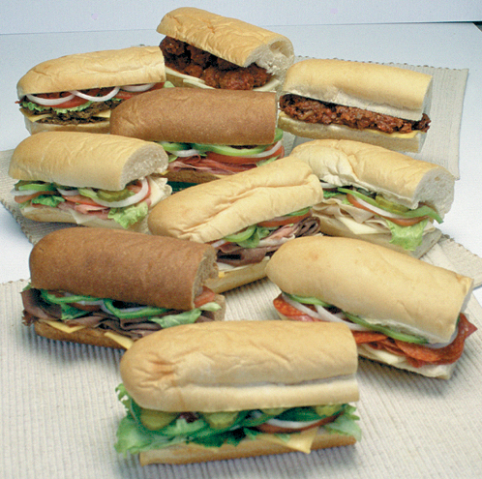
Sandwiches

Slide 64
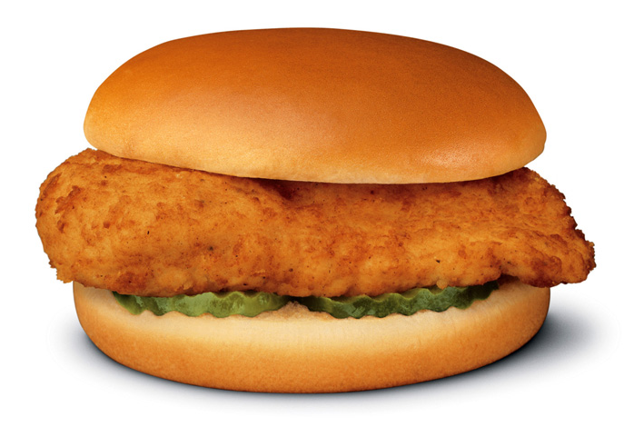
Bread … Meat … Bread
Bread
Meat
Bread

Slide 65
三明治/Sandwich Steps
面包/Bread: 共同的愿景和其他共同点
肉/Meat:
Feedback: giving opinion, judgment, assessment or evaluation (and not necessarily delivering these with the intention of enabling the person receiving the feedback to move ahead or improve performance)
You did something bad, I hate you!
Feedforward: providing observations and assessments coupled with a conversation for possible actions for improving future performance and/or to move ahead in achieving the person’s objectives.
You made mistakes, we can do better!
面包/Bread: 重申共同的远景/赞扬对方的具体进步/希望继续进步reiterate common vision and hope for future progress

Slide 66
如何提供反馈/How to provide feedback
Attacking surfaces
Behavior
Focus on the perceived behavior, and its impact
你来晚了20 分钟, 我们错过了音乐会第一场! 朋友们都进去了。
Pattern, Motive
Pattern of behavior, and motive
你总是这样, 你总是想让我在朋友面前出丑?
Core Property
Core belief, nature of a person
你们男人都不是好东西!

Slide 67
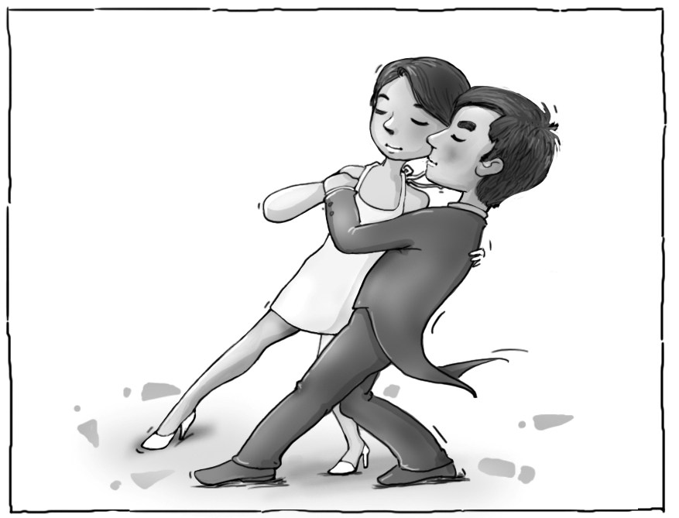
3：Norming / 规范

Slide 68
如何规范/How to NORM better
Establish protocols
Establish patterns
Give positive feedback to your teammate
Establish expected pattern of behavior
Exercise:
Point out things you wish your partners could do

Slide 69
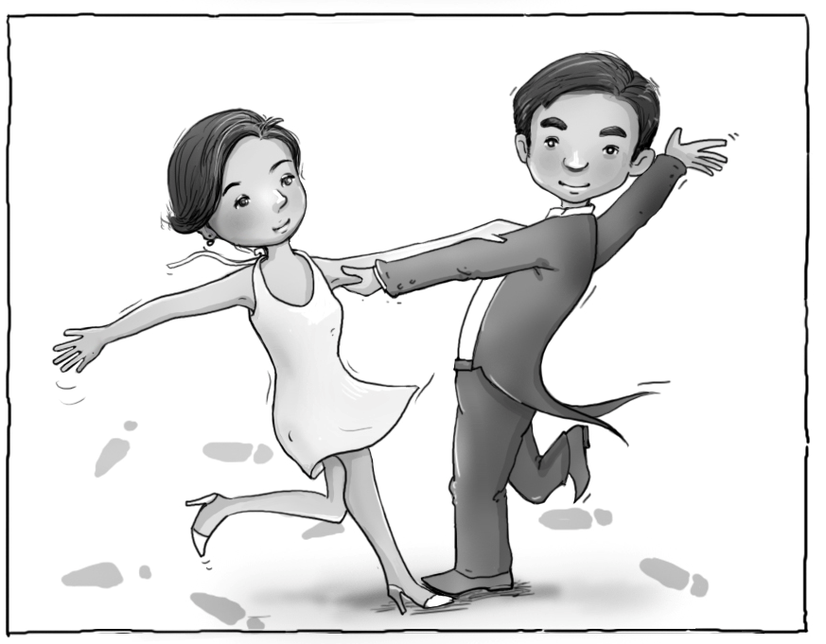
4: Performing / 创造

Slide 70
另一种可能/Another possibility
团队解散/Deforming
画出一幅团队解散的图<ask for best picture to describe “deforming”>
5 分钟，发布到博客上

Slide 71
Now … for team project
The collaboration stage can also apply to a team.
Which stage is your team at?
1: Forming / 萌芽
2: Storming / 磨合
3: Norming / 规范
4: Performing / 创造

Slide 72
Influence
Achieve things by authority
Up-down management
Family
Teacher – student (students can PRETEND to listen…)
Consequence of not listening to authority
Bad – prison guard / prisoner
Achieve things by influence
Peer to peer
Lower to upper
Direct or in-direct
In software teams, influence is the major way to change others
Order doesn’t work well.

Slide 73
Different ways to influence
technique | Assertion / 断言
example | 就是这样吧，听我的，没错！
Logic/feeling | ?
Push / pull | ?
situation | 感情很强烈，适用于有充分信任的同伴。语音、语调、身体语言都能帮助传递强烈的信息。 情况危急时。

Slide 74
Different ways to influence
technique | Bridge / 桥梁
example | 能不能再给我讲讲你分手的理由……
Logic/feeling | ?
Push / pull | ?
situation | 双方并不十分了解

Slide 75
Different ways to influence
technique | Persuasion / 说服
example | 如果我们这样做，根据我的分析，我们会有这样的好处，a、 b、 c……
Logic/feeling | ?
Push / pull | ?
situation | 有条理，建立在逻辑分析的基础上。即使不能全部说服，对方也可能接受部分意见。

Slide 76
Different ways to influence
technique | Attraction / 吸引
example | 你想过舒适的生活么？你想在家里发财么？加入我们的传销队伍吧，几个月后就可以有上万元的收入……
Logic/feeling | ?
Push / pull | ?
situation | 可以有效地传递信息，但是要注意信息的准确性。夸大的渲染会降低个人的可信度

Slide 77
练习/Influence exercise
Pick your favorite technique
Group by your favorite choice
Choose an owner
List 2-3 real life situation when your technique is more appropriate
List 2-3 real life situation when it’s not.
All people move to their next favorite
Owner will do final report

Slide 78
Questions and Answer

Slide 79
Back-up slides

Slide 80
Team project evaluation
What do team members expect you to do?
I can accept failure, everyone fails at something. But I can't accept not trying.
Michael Jordan

Slide 81
Class Exercise – secret vote
Rank your partners, right down the names of all your partners
1) your 1st pair project partner
2) your 2nd pair project partner
3) your team members in team project.
Is he/she a good partner that you really enjoying working with? Best people on top, then going down.
每个人列出一个一维的名单，你自己也在里面，从合作精神最高到最低排列，没有并列。
小伙伴1
小伙伴2
本人
小伙伴3
...
如何打分? “本人” 得到0 分， 比“本人“高一个名次，则加 1 分，低一个名次，则减 1 分， 以此类推。 TA 拿到全部人的提名后，给所有人统计分数。 然后公布。
任课老师决定是否给得分最高的部分同学某种奖励分。
这个可以在学期最后做。

